Slide 1

Introduction to Jenkins
Module 6: Source Control and Multibranch Pipelines

Slide 2
Topics
GitHub and GitLab integration
Webhooks and event-based builds
Multi-branch Pipeline configuration
PR validation workflows

Slide 3
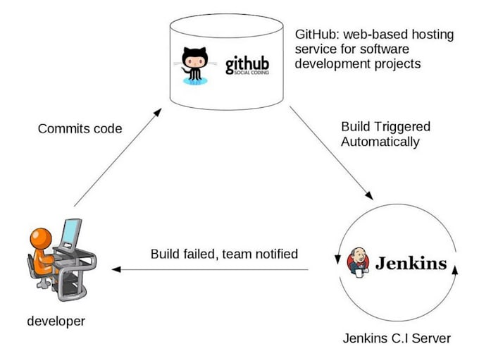
SCM Integration
Modern Jenkins is SCM-driven
  Meaning it responds to events that occur in a code repository
  Removes the need to manually start builds or Jenkins actions
Jenkins responds to events like
  Code changes
  Branch creation
  Pull requests / merge requests
  Tag events

Slide 4
GitHub and GitLab Integration
Jenkins integrates with Git hosting platforms to
  Fetch repositories
  Discover branches and PRs
  Trigger builds
  Report build status back to the repository
Supported platforms include:
  GitHub
  GitLab
  Bitbucket

Slide 5
Authentication
Access to Git platforms uses standard authentication methods
  Personal access tokens
  App-based authentication
  SSH keys
Credentials are stored in Jenkins and injected securely
With proper integration, Jenkins can
  Discover repositories automatically
  Detect new branches
  Build pull requests
  Update commit status (pass/fail)
  Comment on PRs

Slide 6
Discover Repositories
Jenkins can
  Connect to a GitHub or GitLab organization or group
  List available repositories
  Allow admins to select repos without manually entering URLs
This is often done using
  Organization folders
  Access tokens or app integration
Sees the source control system as a catalog, not just a file server

Slide 7
Detect New Branches
Jenkins can
  Detect when a new branch is created
  Automatically create a pipeline for that branch
  Use the Jenkinsfile from that branch
  No manual job creation is required
Benefits
  Feature branches are built automatically
  Teams don’t need to ask for Jenkins jobs
  CI keeps up with modern Git workflows

Slide 8
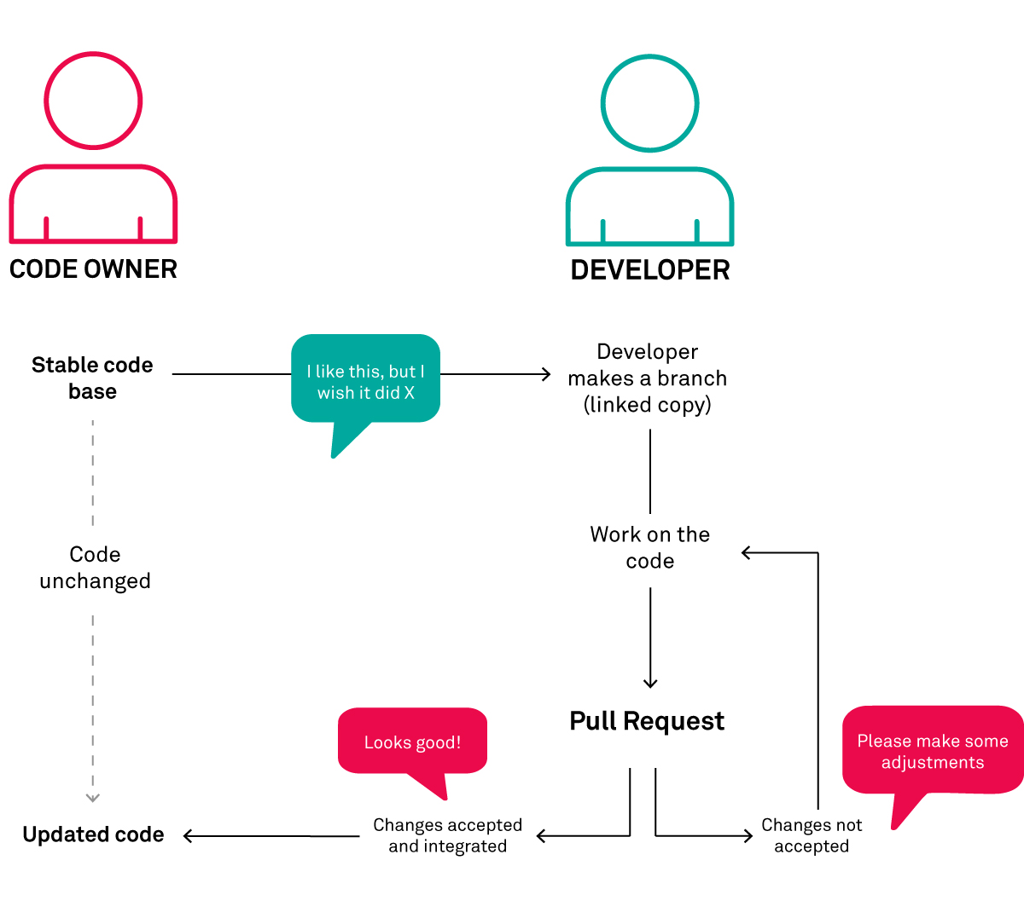
Pull Request (PR) Validation Workflows
PR validation ensures that before code is merged
  It builds successfully
  All the relevant tests pass
  All quality gates and standards are enforced
Typical PR validation flow
  Developer opens PR
  Jenkins detects PR event
  Jenkins runs pipeline
  Results are reported back to the PR
  Merge is allowed or blocked depending on the outcome of the pipeline

Slide 9
Pull Request (PR) Validation Workflows
PR Pipelines usually include
  Build and compile
  Unit tests
  Static analysis
  Security scans
  Linting
Deployments are typically excluded
  These pipelines are part of the CI process, not the deployment process

Slide 10
Build Pull Requests (PRs)
When a PR or merge request is opened
  It triggers a pipeline specifically for the PR
  Tests the proposed changes before merge
  PR builds typically
    Combine the feature branch with the target branch
    Simulates the post-merge state
  Benefits
    Catches integration issues early
    Prevents broken code from being merged
    Shifts quality checks left
  PR builds answer the question
    “Will this code work after it’s merged?”

Slide 11
Update Commit Status (Pass / Fail)
Jenkins can report build results directly back to GitHub or GitLab by
  Updating commit status checks
  Marking builds as:
    Pending
    Successful
    Failed
  These statuses appear
    On commits
    On PRs
    In merge checks
  Developers get feedback without leaving GitHub/GitLab
    Reviewers see CI results instantly
    Branch protection rules can block merges on failure
  Jenkins becomes part of the code review process.

Slide 12
Comment on Pull Requests
Jenkins can:
  Post comments on PRs
  Include build summaries
  Link to logs and reports
  Provide actionable feedback
Examples:
  “Build failed: unit tests”
  “Quality gate failed”
  “Security scan detected vulnerabilities”
Benefits
  Feedback is contextual and visible
  Developers don’t need to check Jenkins manually
  Improves collaboration and speed
  CI feedback should live where developers work

Slide 13
Typical Integrated Workflow
Developer pushes code and creates a PR
GitHub/GitLab sends an event
Jenkins triggers the correct pipeline
Pipeline runs tests and checks
Jenkins reports results back to the PR
Merge is allowed or blocked automatically

Slide 14
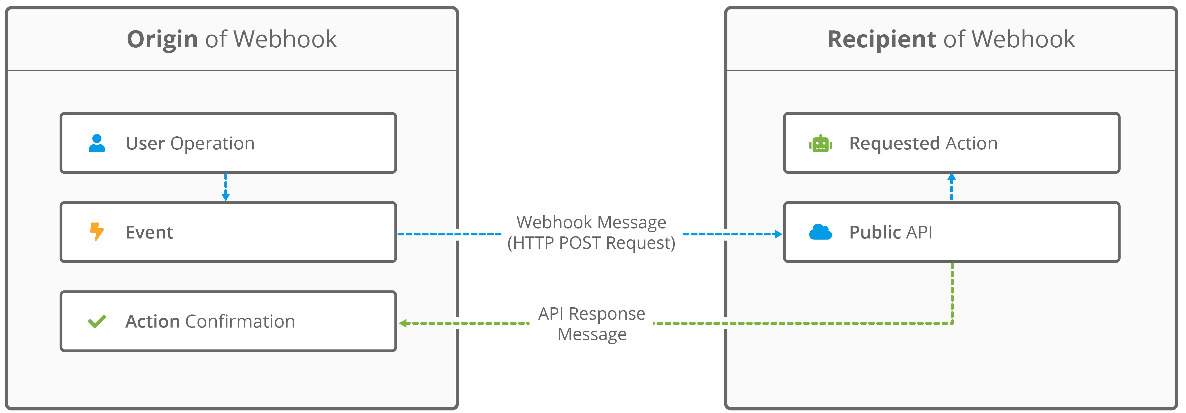
Webhooks and Event-Based Builds
A webhook is an HTTP callback sent by GitHub or GitLab when an event occurs.
Examples of events
  Push to a branch
  Pull request opened
  Pull request updated
  Merge request created

Slide 15
Webhooks and Event-Based Builds
Without webhooks
  Jenkins polls repositories periodically
  Builds are delayed
  Unnecessary load is created
With webhooks
  Builds trigger immediately
  Jenkins reacts in near real time
  CI feedback is faster
Webhooks turn Jenkins from a poller into a listener

Slide 16
Typical Webhook Flow
Developer pushes code
GitHub/GitLab sends webhook
Jenkins receives event
Jenkins determines which pipeline applies
Build starts

Slide 17
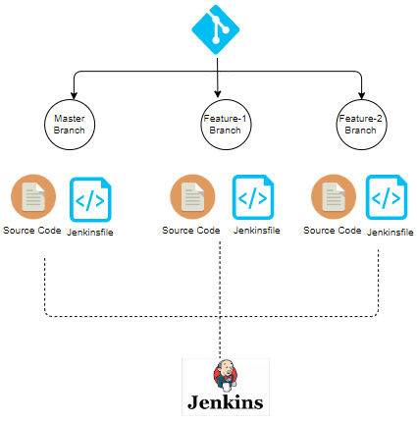
Multibranch Pipeline
A single Jenkins job that automatically manages many pipelines
  One for each branch in a source control repository.
Instead of manually creating
  One job per branch
  One job per feature
  One job per team
Jenkins handles this automatically
A multibranch pipeline job
  Scans a Git repository
  Discovers branches and pull requests
  Creates a pipeline per branch
  Runs the pipeline defined in that branch

Slide 18
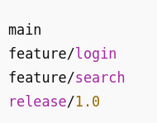
Multibranch Pipeline
Given the repo structure on the right
  With a multibranch pipeline Jenkins creates four pipelines
  Each pipeline
    Uses the Jenkinsfile from its own branch
    Runs independently
    Has its own build history
    Can succeed or fail without affecting others
    For example “if feature/login fails, main is unaffected”
  Jenkins reads a Jenkinsfile from the branch itself so each branch can define its own behavior.
  main branch:
    Runs full tests
    Builds artifacts
    Deploys
  feature/* branches:
    Run fast tests only
    Skip deployments
  This is done using branch-aware logic inside the branch Jenkinsfiles

Slide 19
Multibranch Pipeline
Multibranch pipelines allow Jenkins to automatically build feature branches
Developers don’t need to
  Ask for a Jenkins job
  Copy an existing pipeline
  Configure anything manually
They just
  Create a branch
  Add a Jenkinsfile
  Push code
  Jenkins does the rest

Slide 20
Multibranch Pipeline
Multibranch pipelines allow Jenkins to validate changes before merge
Before code is merged
  Jenkins builds the branch
  Tests run automatically
  Failures are caught early
This prevents
  Broken main branches
  Last-minute integration issues
CI happens before merge, not after

Slide 21
Jenkinsfile Requirement
A Jenkinsfile is mandatory for Jenkins to build a branch
  The branch must contain a Jenkinsfile
  The file defines
    Stages
    Steps
    Agents
    Environment
    Logic
  No Jenkinsfile = no pipeline

Slide 22
Multibranch Pipeline Benefits
Because the Jenkinsfile is part of the branch
  Pipelines are versioned
  Changes are reviewed
  CI evolves alongside the application
This enables
  Branch-specific logic
  Example
    New branch experiments with a new test framework
    Old branches continue using the old one
  Experimental pipelines
    Try new pipeline ideas
    Test tooling changes
    Validate performance improvements
    Without impacting production pipelines

Slide 23
Branch Discovery
Jenkins scans the repository
  Finds branches and PRs
  Decides which ones to build
  This can happen periodically through polling
  Or can happen in response to webhooks
This behavior is configurable

Slide 24
Common Discovery Options
Jenkins can be configured for discovery
Discover all branches
  Builds everything
  Useful for small teams or learning environments
Exclude certain branches
  Examples:
    Ignore docs/*
    Ignore archived branches
    Ignore experimental branches
Build only branches with changes
  Avoids rebuilding inactive branches
  Reduces load on Jenkins

Slide 25
Questions

